Slide 1
PRiSM 2
Sprint 3 - Show And Tell

Slide 2
Contents
Updated PRiSM user interface – Juan
Integration with Portico finished! – Kevin
Multiple Persistent Application Filters – Jakub, Wei
Application Attention Flag – Jakub
Added an autosuggest to find users – Kevin
Delegating Interviewer Administration – Claudio, Jakub
Bugfixes and behind the scenes
Upcoming Features (Email)

Slide 3
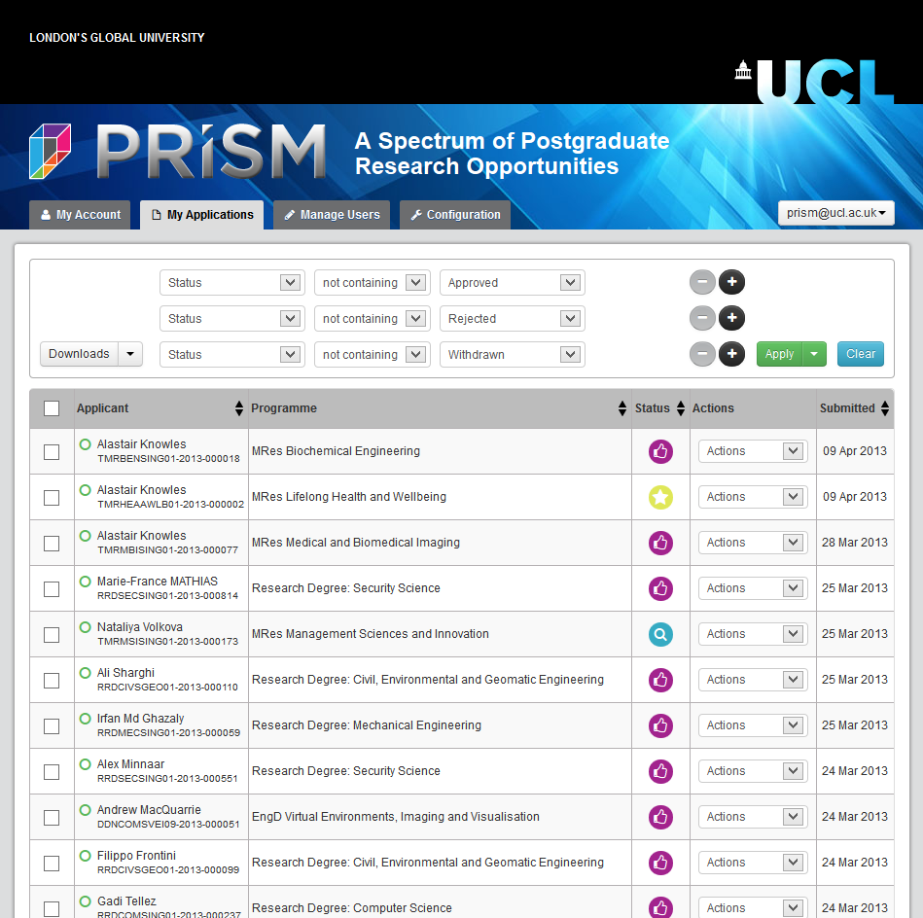
Updated PRiSM user interface
We’ve updated the PRiSM user interface to reduce the number of layout issues with different browsers and in order to improve the user experience.

Slide 4
Integration with Portico finished!
Whenever an application gets Approved it will be sent to the student record system immediately.
Whenever an application gets Withdrawn or Rejected the application will be sent to the student record system in an nightly batch.

Slide 5
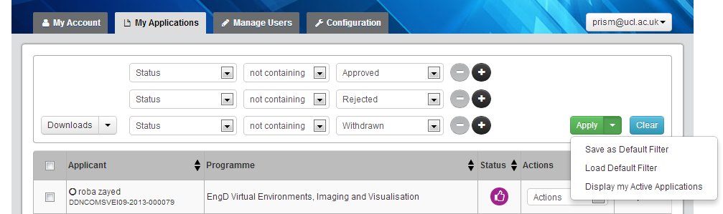
Multiple Persistent Application Filters
It is now possible to filter applications using multiple search criteria. For example: “Show me all applications for Research Degree: Computer Science which have been approved”
These filters can be persisted and reloaded.

Slide 6
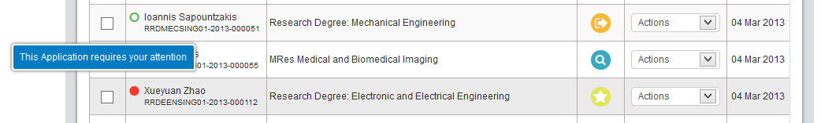
Application Attention Flag
We’ve added an “Attention Flag” to the applications overview which helps you quickly to find applications that need the attention of an administrator, reviewer, interviewer etc. depending on your PRiSM role.
Whereas means: “nothing to do” and means “this application needs your attention”.

Slide 7
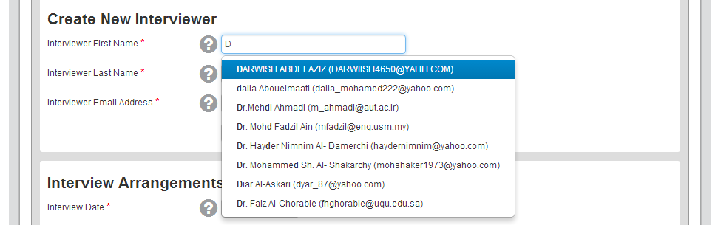
Added an autosuggest to find users
Start typing either in the first name, last name or email address field to get a list of users which match the provided criteria.
This has been added to all the administration forms where you can select Interviewers, Reviewers, Supervisors, etc.

Slide 8
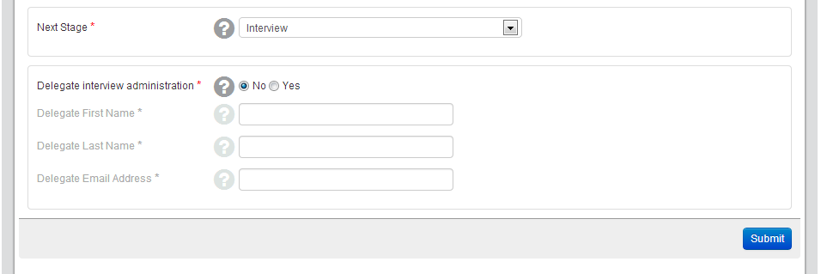
Delegating Interviewer Administration
It is now possible to delegate the interview administration whenever an application is about to enter the Interview stage. Previously this was only possible when the application moved from Review into the Interview stage.

Slide 9
Bugfixes and behind the scenes
Fixed several browser-independent issues
Fixed a couple of applications in production which could not be approved
Fixed an application form error when saving the personal details section
Fixed a display issue in the application form regarding the contact address
Added a feature which allows the editing of email templates
Preparation and go live with the student record system interface

Slide 10
Upcoming Features
Reduction of emails sent from PRiSM
In the upcoming Sprint we’ll introduce a daily digest which drastically reduces the number of emails sent from PRiSM.
You’ll only receive one email a day if there are applications that need your attention.
Some emails will still be sent as soon as the respective event happens (i.e. applicant submits application)
More bugfixes and additional features
To be prioritised this afternoon.

